Slide 1
Coordinate Geometry COGO

Slide 2
COGO
Computations for determining
Positional relationships between coordinate pairs.
Using trig to solve point positions
N
N=?
E=?
N
a
(N, E)
a=?
L
L=?
(N, E)
(N, E)

Slide 3
COGO
Based on plane trigonometry; emphasis on triangle solutions.
Computations limited to plane surveying which simplifies them.
c
A
b
B
C
a

Slide 4
A. Coordinates
1. Definition
A reference system (datum) for expressing horizontal positions

Slide 5
A. Coordinates
2. Characteristics
A reference system (datum) for expressing horizontal positions
Two reference axes
Perpendicular
Uniform scaling

Slide 6
A. Coordinates
3. Position
a. Absolute
Absolute position expressed by perpendicular linear distances from the axes.
X and Y axes
Y
X_{A}
Y_{A}
X
(0,0)

Slide 7
A. Coordinates
3. Position
a. Absolute
Absolute position expressed by perpendicular linear distances from the axes.
North and East axes
North
E_{A}
A (N_{A}, E_{A})
N_{A}
East
(0,0)

Slide 8
A. Coordinates
3. Position
a. Absolute
Absolute position expressed by perpendicular linear distances from the axes.
We’ll use North-East (N,E) coordinate nomenclature
North
B (N_{B}, E_{B})
E_{B}
N_{B}
E_{A}
A (N_{A}, E_{A})
N_{A}
East
(0,0)

Slide 9
A. Coordinates
3. Position
a. Relative
Relative position is distance and direction from one point to another
North
B
L_{AB} & Dir_{AB}
A
East
(0,0)

Slide 10
A. Coordinates
4. Forward Computation
Computing coords (absolute) from dist and dir (relative)
North
B (?, ?)
L_{AB} & Dir_{AB}
A (N_{A}, E_{A})
Must have a starting coordinate
East
(0,0)

Slide 11
A. Coordinates
4. Forward Computation
Computing coords (absolute) from dist and dir (relative)
Latitude (Lat)
N/S line component
N is (+), S is (-)
Departure (Dep)
E/W line component
E is (+), W is (-)
North
B (?, ?)
Dep_{AB}
Lat_{AB}
L_{AB} & Dir_{AB}
A (N_{A}, E_{A})
East
(0,0)

Slide 12
A. Coordinates
4. Forward Computation
Computing coords (absolute) from dist and dir (relative)
Lat = L x cos(Dir)
Dep = L x sin(Dir)
North
B (?, ?)
Dep_{AB}
Dir_{AB}
Lat_{AB}
L_{AB}
A (N_{A}, E_{A})
East
(0,0)

Slide 13
A. Coordinates
4. Forward Computation
Computing coords (absolute) from dist and dir (relative)
Lat = L x cos(Dir)
Dep = L x sin(Dir)
N_{B} = N_{A} +Lat_{AB}
E_{B} = E_{A} + Dep_{AB}
North
B (N_{B}, E_{B})
Dep_{AB}
Dir_{AB}
Lat_{AB}
L_{AB}
A (N_{A}, E_{A})
East
(0,0)

Slide 14
A. Coordinates
4. Forward Computation
Computing coords (absolute) from dist and dir (relative)
0° ≤ Brng ≤ 90°
Lat = L x cos(Brng) ◻ (+)
Dep = L x sin(Brng) ◻ (+)
Lat & Dep sign det’d by Brng quad
+Lat
-Dep
N
+Lat
+Dep
Brng
Brng
W
E
Brng
Brng
-Lat
-Dep
-Lat
+Dep
S

Slide 15
A. Coordinates
4. Forward Computation
Computing coords (absolute) from dist and dir (relative)
0° ≤ Az ≤ 360°
Lat = L x cos(Az)
Dep = L x sin(Az)
Using Az results in correct sign for Lat & Dep
+Lat
-Dep
N
+Lat
+Dep
Az
Az
W
E
Az
Az
-Lat
-Dep
-Lat
+Dep
S

Slide 16
A. Coordinates
4. Forward Computation
Computing coords (absolute) from dist and dir (relative)
Lat & Dep Example:
Line AB: 156.39 S35°18’20”E
Lat =
Dep =
Line ST: 203.66 Az 235°23’50”
Lat =
Dep =
A
B
S
T

Slide 17
A. Coordinates
4. Forward Computation
Computing coords (absolute) from dist and dir (relative)
Lat & Dep Example:
Line AB: 156.39 S35°18’20”E
Lat = 156.39 x cos(35°18’20”) = 127.627 ◻ -127.627
Dep = 156.39 x sin(35°18’20”) = 90.384 ◻ +90.384
Line ST: 203.66 Az 235°23’50”
Lat =
Dep =
A
B
S
T

Slide 18
A. Coordinates
4. Forward Computation
Computing coords (absolute) from dist and dir (relative)
Lat & Dep Example:
Line AB: 156.39 S35°18’20”E
Lat = 156.39 x cos(35°18’20”) = 127.627 ◻ -127.627
Dep = 156.39 x sin(35°18’20”) = 90.384 ◻ +90.384
Line ST: 203.66 Az 235°23’50”
Lat = 203.66 x cos(235°23’50”) = -115.655
Dep = 203.66 x sin(235°23’50”) = -167.634
A
B
S
T

Slide 19
A. Coordinates
5. Inverse Computation
Computing dist and dir from coords
DE
D
DN = Lat_{CD} = N_{D}-N_{C}
DE = Dep_{CD} = E_{D}-E_{C}
to minus from
DN
a
L_{CD}
C

Slide 20
A. Coordinates
5. Inverse Computation
Computing dist and dir from coords
 | Algebraic sign of:
Quad | ΔN | ΔE | α | Bearing | Azimuth
NE | + | + | + | N α E | α
SE | – | + | – | S | α | E | 180°+ α
SW | – | – | + | S α W | 180°+ α
NW | + | – | – | N | α | W | 360°+ α
N
"
"
W
E
"
"
S

Slide 21
A. Coordinates
5. Inverse Computation
Computing dist and dir from coords
Example: Length and direction of Q to W
Q
Point | North (ft) | East (ft)
Q | 833.77 | 310.41
W | 418.61 | 548.01
W
DN =
DE =

Slide 22
A. Coordinates
5. Inverse Computation
Computing dist and dir from coords
Example: Length and direction of Q to W
Q
Point | North (ft) | East (ft)
Q | 833.77 | 310.41
W | 418.61 | 548.01
W
DN = 418.61 – 833.77 = -416.16
DE = 548.01 – 310.41 = +237.60

Slide 23
A. Coordinates
5. Inverse Computation
Computing dist and dir from coords
Example: Length and direction of Q to W
Q
Point | North (ft) | East (ft)
Q | 833.77 | 310.41
W | 418.61 | 548.01
W
DN = 418.61 – 833.77 = -416.16
DE = 548.01 – 310.41 = +237.60

Slide 24
A. Coordinates
5. Inverse Computation
Computing dist and dir from coords
Example: Length and direction of Q to W
Q
Point | North (ft) | East (ft)
Q | 833.77 | 310.41
W | 418.61 | 548.01
W
DN = 418.61 – 833.77 = -416.16
DE = 548.01 – 310.41 = +237.60
E
S

Slide 25
A. Coordinates
5. Inverse Computation
Computing dist and dir from coords
Example: Length and direction of Q to W
Q
Az
Point | North (ft) | East (ft)
Q | 833.77 | 310.41
W | 418.61 | 548.01
Brng
W
DN = 418.61 – 833.77 = -416.16
DE = 548.01 – 310.41 = +237.60
E
S
Brng_{QW} = S 29°43’25”E
Az_{QW} = 180°00’00”-29°43’25”
= 150°16’35”

Slide 26
B. Plane Trigonometry
1. Triangle formulae
Angle condition
A + B + C = 180°00’00”
Law of Sines
Law of Cosines
Area
A
c
b
B
C
a

Slide 27
B. Plane Trigonometry
1. Triangle formulae
A triangle has three angles and three sides.
In order to geometrically fix the triangle you must start with at least three parts and one of those must be a side.
Both have same angles

Slide 28
B. Plane Trigonometry
1. Triangle formulae
In order to geometrically fix the triangle you must start with at least three parts and one of those must be a side.
c
A
c
A
b
b
B
C
B
C
a
a

Slide 29
B. Plane Trigonometry
1. Triangle formulae
In order to geometrically fix the triangle you must start with at least three parts and one of those must be a side.
c
A
c
A
b
b
B
C
B
C
a
a
Law of Cosines
a² = b² + c² - 2 x(bc)xCos(∠A)

Slide 30
B. Plane Trigonometry
1. Triangle formulae
In order to geometrically fix the triangle you must start with at least three parts and one of those must be a side.
c
A
c
A
b
b
B
C
B
C
a
a
Law of Cosines
a² = b² + c² - 2 x(bc)xCos(∠A)
Can then use either Law of Cosines or Sines to solve the remaining parts.

Slide 31
B. Plane Trigonometry
1. Triangle formulae
In order to geometrically fix the triangle you must start with at least three parts and one of those must be a side.
c
A
c
A
b
b
B
C
B
C
a
a
Law of Cosines
a² = b² + c² - 2 x(bc)xCos(∠A)
Law of Cosines
a² = b² + c² - 2 x(bc)xCos(∠A)
Can then use either Law of Cosines or Sines to solve the remaining parts.

Slide 32
B. Plane Trigonometry
1. Triangle formulae
In order to geometrically fix the triangle you must start with at least three parts and one of those must be a side.
c
A
c
A
b
b
B
C
B
C
a
a
Law of Cosines
a² = b² + c² - 2 x(bc)xCos(∠A)
Law of Cosines
a² = b² + c² - 2 x(bc)xCos(∠A)
Can then use either Law of Cosines or Sines to solve the remaining parts.
Can then use either Law of Cosines or Sines to solve the remaining parts.

Slide 33
B. Plane Trigonometry
1. Triangle formulae
In order to geometrically fix the triangle you must start with at least three parts and one of those must be a side.
c
A
c
A
b
b
B
C
B
C
a
a

Slide 34
B. Plane Trigonometry
1. Triangle formulae
In order to geometrically fix the triangle you must start with at least three parts and one of those must be a side.
c
A
c
A
b
b
B
C
B
C
a
a
Start with the angle condition
180° = ∠A + ∠B + ∠C

Slide 35
B. Plane Trigonometry
1. Triangle formulae
In order to geometrically fix the triangle you must start with at least three parts and one of those must be a side.
c
A
c
A
b
b
B
C
B
C
a
a
Start with the angle condition
180° = ∠A + ∠B + ∠C
Then Law of Sines to solve another side.
Then Law of Cosines or Sines to solve the remaining side.

Slide 36
B. Plane Trigonometry
1. Triangle formulae
In order to geometrically fix the triangle you must start with at least three parts and one of those must be a side.
c
A
c
A
b
b
B
C
B
C
a
a
Start with the angle condition
180° = ∠A + ∠B + ∠C
Start with Law of Sines
a c
=
Sin(∠A) Sin(∠C)
Then Law of Sines to solve another side.
Then Law of Cosines or Sines to solve the remaining side.

Slide 37
B. Plane Trigonometry
1. Triangle formulae
In order to geometrically fix the triangle you must start with at least three parts and one of those must be a side.
c
A
c
A
b
b
B
C
B
C
a
a
Start with the angle condition
180° = ∠A + ∠B + ∠C
Start with Law of Sines
a c
=
Sin(∠A) Sin(∠C)
Then Law of Sines to solve another side.
Then Law of Cosines or Sines to solve the remaining side.
Then angle condition to solve last angle.
Then Law of Sines to solve the last side.

Slide 38
B. Plane Trigonometry
1. Triangle formulae
In order to geometrically fix the triangle you must start with at least three parts and one of those must be a side.
c
A
c
A
b
b
B
C
B
C
a
a

Slide 39
B. Plane Trigonometry
1. Triangle formulae
In order to geometrically fix the triangle you must start with at least three parts and one of those must be a side.
c
A
c
A
b
b
B
C
B
C
a
a
Start with Law of Sines
b c
=
Sin(∠B) Sin(∠C)

Slide 40
B. Plane Trigonometry
1. Triangle formulae
In order to geometrically fix the triangle you must start with at least three parts and one of those must be a side.
c
A
c
A
b
b
B
C
B
C
a
a
Start with Law of Sines
b c
=
Sin(∠B) Sin(∠C)
Then angle condition to solve last angle.
Then Law of Sines to solve the last side.

Slide 41
B. Plane Trigonometry
1. Triangle formulae
In order to geometrically fix the triangle you must start with at least three parts and one of those must be a side.
c
A
c
A
b
b
B
C
B
C
a
a
Start with Law of Sines
b c
?
=
Sin(∠B) Sin(∠C)
Then angle condition to solve last angle.
Then Law of Sines to solve the last side.

Slide 42
B. Plane Trigonometry
1. Triangle formulae
In order to geometrically fix the triangle you must start with at least three parts and one of those must be a side.
c
A
c
A
b
b
B
C
B
C
a
a
Start with Law of Sines
b c
Can’t be solved.
=
Sin(∠B) Sin(∠C)
Then angle condition to solve last angle.
Then Law of Sines to solve the last side.

Slide 43
B. Plane Trigonometry
2. Trigonometric functions
a. Sine
Sine Curve
This curve repeats itself every 360°.
The sine of any angle falls between -1 and +1.
Sine Curve
1.0
0.5
Sine
0.0
-0.5
-1.0
-180
-90
0
90
180
270
360
450
Angle, in degrees

Slide 44
B. Plane Trigonometry
2. Trigonometric functions
a. Sine
The inverse sine of a number between -1 and +1 on a calculator will always return an angle between –90° and +90°.
1.0
Angle | x = sin(Angle) | sin⁻¹(x) | relationship
30° | +0.500000 | +30° | Angle
150° | +0.500000 | +30° | 180° - Angle
210° | -0.500000 | -30° | 180° - Angle
330° | -0.500000 | -30° | 360° + Angle
0.5
Sine
0.0
-0.5
-1.0
-180
-90
0
90
180
Angle, in degrees

Slide 45
B. Plane Trigonometry
2. Trigonometric functions
a. Sine
To solve a triangle using the law of sines you must have either:
two angles and a side, or,
two sides and an angle
c
A
b
B
C
a

Slide 46
B. Plane Trigonometry
2. Trigonometric functions
a. Sine
Example
For a triangle ABC, a = 12.4', b = 8.7', and B = 36°40'.
Compute the remaining angles and side.
From Law of Sines

Slide 47
B. Plane Trigonometry
2. Trigonometric functions
a. Sine
Example
There are two angles whose sine is +0.85112:
A₁ = 58°20’
A₂ = 180°00’ – 58°20’ = 121°40’
C
Sine Curve
1.0
+0.85112
12.4'
0.5
8.7'
8.7'
36°40'
0.0
A₁
A₂
-0.5
B
-1.0
0
90
180
270
360
58°20’
121°40’

Slide 48
B. Plane Trigonometry
2. Trigonometric functions
a. Sine
Example
For A₁ = 58°20’
C₁ = 180°00’-(36°40’+58°20’)
= 85°00’
C
12.4'
C₁
8.7'
36°40'
A
1
B
A
14.5'

Slide 49
B. Plane Trigonometry
2. Trigonometric functions
a. Sine
Example
For A₂ = 121°40’
C₂ = 180°00’-(36°40’+121°40’)
= 21°20’
C
12.4'
C₂
8.7'
36°40'
A₂
B
A
5.4'

Slide 50
B. Plane Trigonometry
2. Trigonometric functions
a. Sine
Example
Compute the value of angle β:
(1) By Law of Sines
(2) By angle condition
48°
158.4 ft
b
24°
123.8 ft

Slide 51
B. Plane Trigonometry
2. Trigonometric functions
a. Sine
Example
Compute the value of angle β:
(1) By Law of Sines
(2) By angle condition
48°
158.4 ft
b
24°
123.8 ft
Be careful using the Law of Sines to solve for an unknown angle – there could be two possible answers only one of which will fit the particular triangle.

Slide 52
B. Plane Trigonometry
2. Trigonometric functions
b. Cosine
This curve repeats itself every 360°.
The cosine of any angle falls between -1 and +1.
Cosine Curve
1.0
0.5
Cosine
0.0
-0.5
-1.0
-180
-90
0
90
180
270
360
450
Angle, in degrees

Slide 53
B. Plane Trigonometry
2. Trigonometric functions
b. Cosine
The inverse cosine of a number between +1 and -1 on a calculator will always return an angle between 0° and +180°.
1.0
Angle | x = cos(Angle) | cos⁻¹(x)
60° | +0.500000 | +60°
300° | +0.500000 | +60°
120° | -0.500000 | +120°
-240° | -0.500000 | +120°
0.5
Cosine
0.0
-0.5
-1.0
0
90
180
270
360
Angle, in degrees

Slide 54
B. Plane Trigonometry
2. Trigonometric functions
b. Cosine
To solve a triangle using the law of cosines you must have either:
three sides, or,
two sides and an angle

Slide 55
B. Plane Trigonometry
2. Trigonometric functions
b. Cosine
Example
Compute the value of the angle ρ in the triangle:
From the Law of Cosines:
163.9 ft
135.7 ft
r
282.3 ft

Slide 56
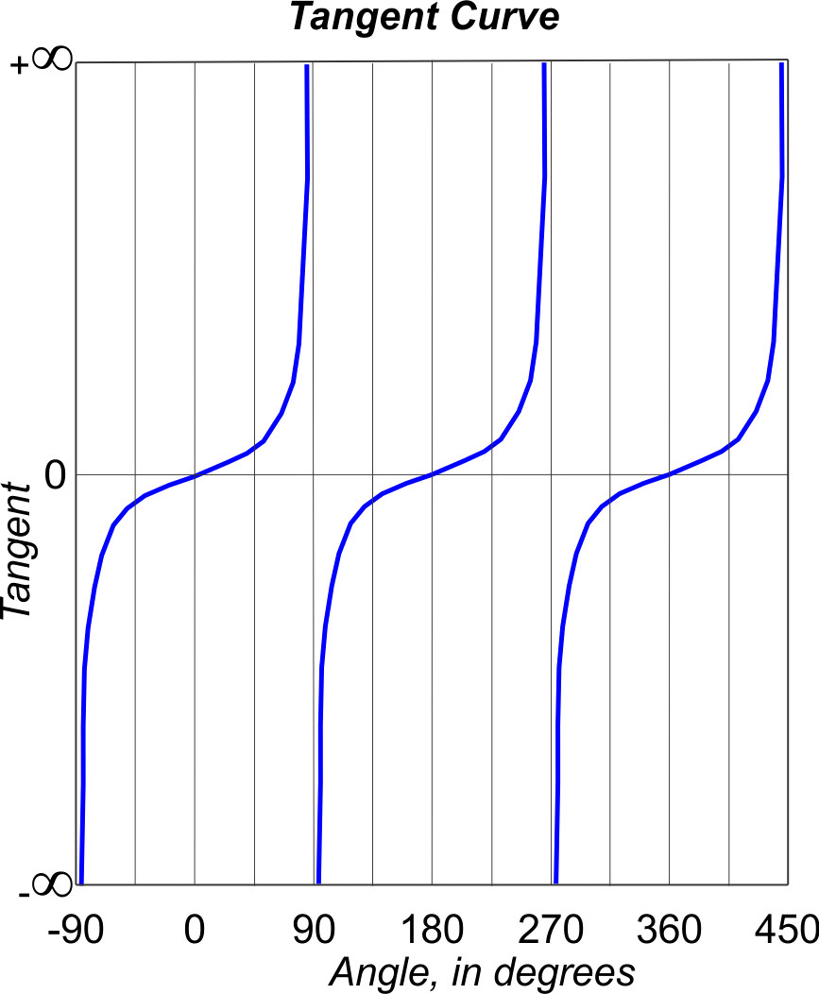
B. Plane Trigonometry
2. Trigonometric functions
c. Tangent
Tangent of an angle is not limited to ±1.0
Range is ±(infinity)
Repeats every 180°
Asymptotic at 90°, 270°, ...
There’s a Law of Tangents,
but we generally don’t need it.

Slide 57
L
Questions?
V
U

